Slide 1

FINAL YEAR PROJECT I
Activity Management System for Teachers and Administrators in Public Primary School
FATIN QISTINA BINTI NAHAR
17126915/1

Slide 2
Modules I have done
Assign Task
Meeting Invitation
Meeting Info
Create / Add
View
Delete

Slide 3
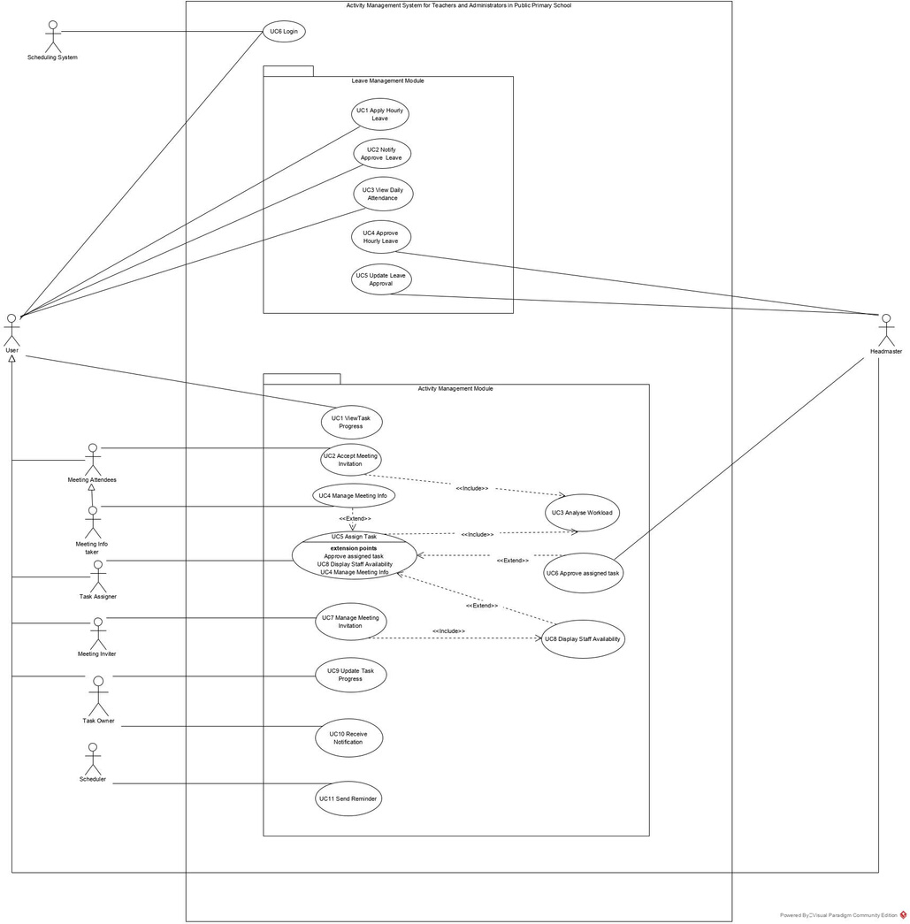
Use Case Diagram – My module & my partner’s module

Slide 4
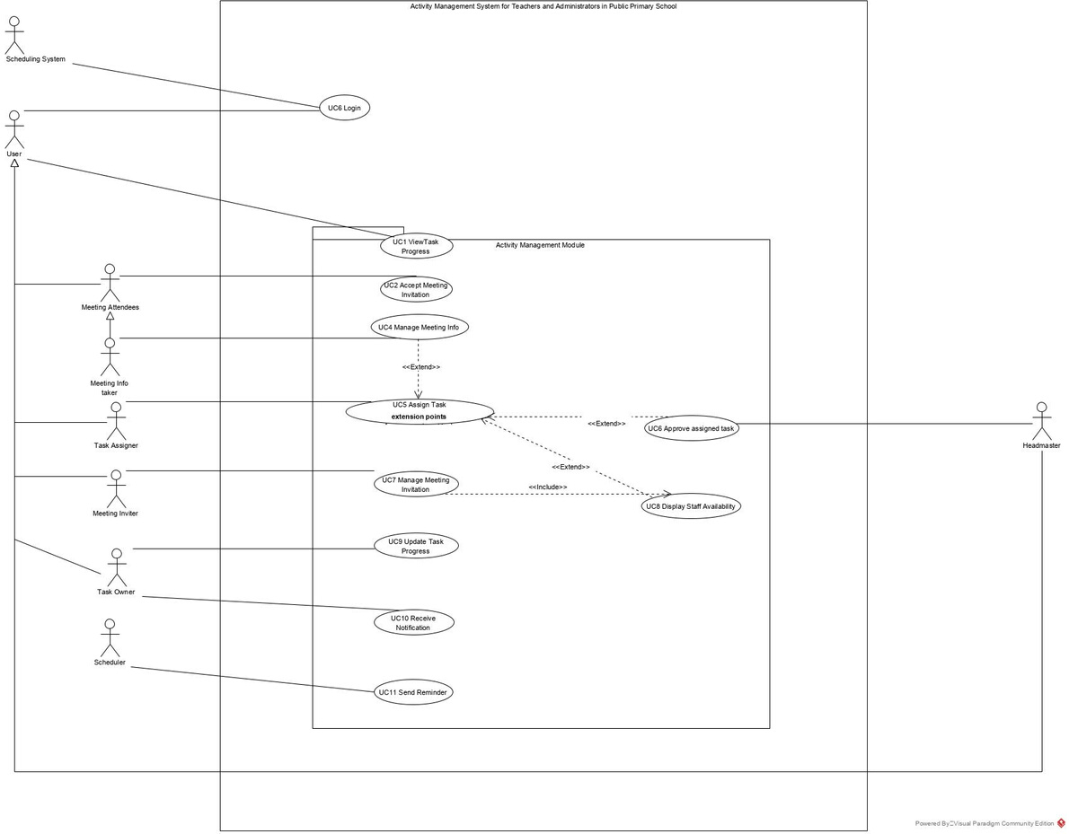
Use Case Diagram - My module

Slide 5
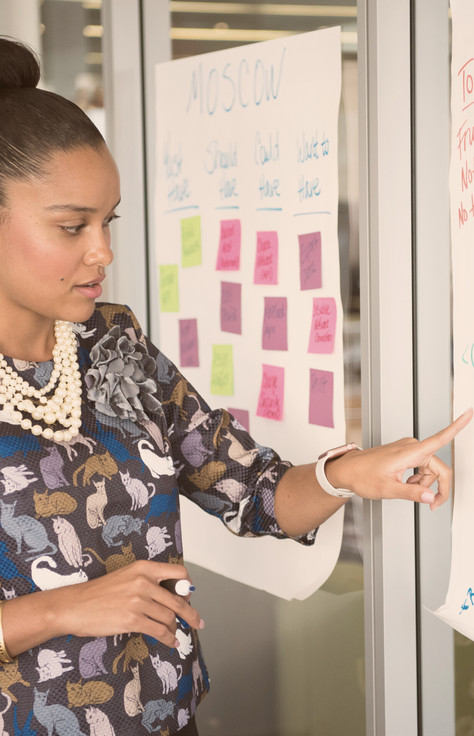
Presentation Outline
Project Objectives
Problem Statements
Literature Review
Methodology
Stakeholder Collaboration Proof
Requirements
Analysis & Design
Mastery of Tools
References

Slide 6

PROJECT OBJECTIVES
To find out the workflow of activity management in primary school.
To develop a web application that allows the staff to manage their leaves and keep track their task
To provide a platform for staff recording either meeting or non-meeting tasks.
To formulate an application that would help the staff prioritize their daily activities and tasks.
To analyse the necessity of the application among staff in primary school.

Slide 7
School does not have a proper platform for activity management that consist of task management, meeting management and leave management.
Heavy traffic of messages in WhatsApp or Telegram subsequently the teacher fails to notice some of the meeting invitations.
Problem Statement
Current hourly leave attendance system is not reliable as it requires the teachers to manually log their attendance in the book. This interrupt meeting inviter from checking the availability of teachers due to scatter of daily attendance log.
Unsystematic leave application as unavailable of notification to principal when leave application made by staff. Requires to manually notify the principal for approval.
Unbalance tasks distribution among staff as the task are blindly given without considering existing number of tasks, difficulty and duration of completing the tasks.

Slide 8

LINK TO LITERATURE REVIEW

Slide 9



Existing System - Meeting system
Free meeting scheduling software
Sync to user’s calendar to allow organizer to see participant availability.
The scheduling is automated and has ability to send group meeting links.
Meeting management software
Designed to organize and manage meeting
load with an interactive interface.
Allow team to create and edit agenda for meeting attendee
Send meeting reminders
Able to create and modify action points to send meeting attendee for feedback.
A meeting management software
Allow user to manage meeting steps from pre meeting to post meeting.
Lets user create an agenda, schedule meetings, invitation management, task assignment and meeting minutes management.

Slide 10



Existing System - Task Management
An online task manager
Provide a to-do list for managing personal tasks, notifications for new tasks assigned and task comments.
A task manager software
Able to monitor individual and team tasks.
lets user to track task from beginning to end, assign task to team and set deadlines.
Task management software
Allow users to organize their meeting like end-to-end project management.
Allow user to send email reminders of meetings to all team member
Allows the organizer to share meeting info with meeting attendee
Send meeting invitation to limitless team members
Allow user to share their meeting materials for review by other team.

Slide 11

Methodology
Software Development Life Cycle
Iterative Model
Requirements Elicitation
Survey
Interview
Prototype

Slide 12
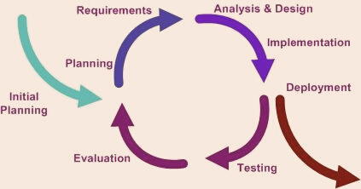
SOFTWARE DEVELOPMENT LIFE CYCLE (SDLC)
Planning and requirement analysis
Defining requirements
Designing the product architecture
Building or developing the product
Testing the product
Deployment in the market and maintenance
ITERATIVE MODEL
Easier to test and debug during a smaller iteration
Risks are identified and resolved during iteration
Provides more and more flexible and enhance based on requirements
Limited time spent on documentation and extra time on designing.

Slide 13
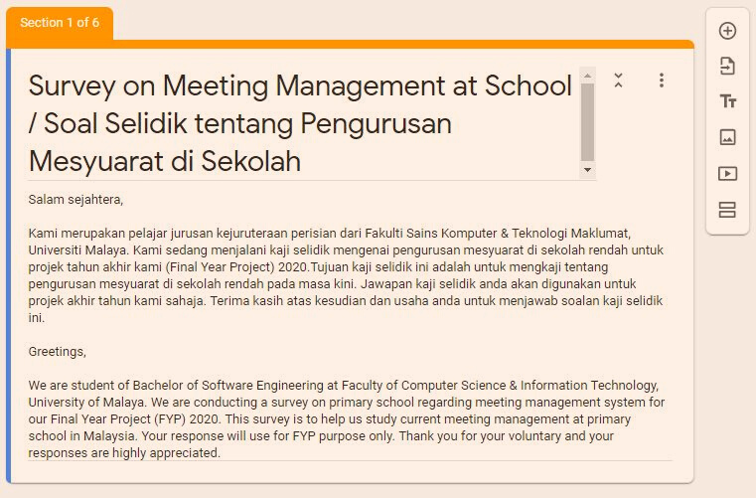
Requirement Elicitation
SURVEY
We have conducted a survey to a group of 40 respondents who are classified as teachers or administrative from public
primary schools around Malaysia

Slide 14


Survey Questions
LINK

Slide 15


Survey Result I
CHECK STAFF AVAILABILITY
90% of respondents are using WhatsApp & Telegram
10% of respondents are using management book
MEETING INVITATION
90% of respondents are using WhatsApp & Telegram
10% of respondents are using letter
FAIR TASK DIVISION
10% of respondents are still having problem in fair task division

Slide 16
Survey Result II
ACCEPT & REJECT FUNCTIONALITY FOR MEETING INVITATION
70% of the respondents found out that accept and reject functionality would be useful to manage their meetings
REMINDER FOR MEETINGS
90% of respondents prefer to have a reminder for meetings because can help in planning activities and also to ensure full attendance

Slide 17
Survey Result III
MINUTES OF MEETING
90% of respondents stated that the minutes of meeting are
viewed in Telegram group.
10% of respondents still using manual process
which is on paper minutes of meeting distribution.

Slide 18
Survey Result IV
LEAVE APPLICATION
All respondents apply leave to the government system, HRMIS
and need to notify the Headmaster manually to make approval in the system.
HOURLY LEAVE APPLICATION
65% of the respondents apply for hourly leave manually by
filling in form and some of them stated it is difficult in getting approval

Slide 19
Survey Result IV
FOR FULL RESULTS PLEASE GO TO THIS LINK

Slide 20
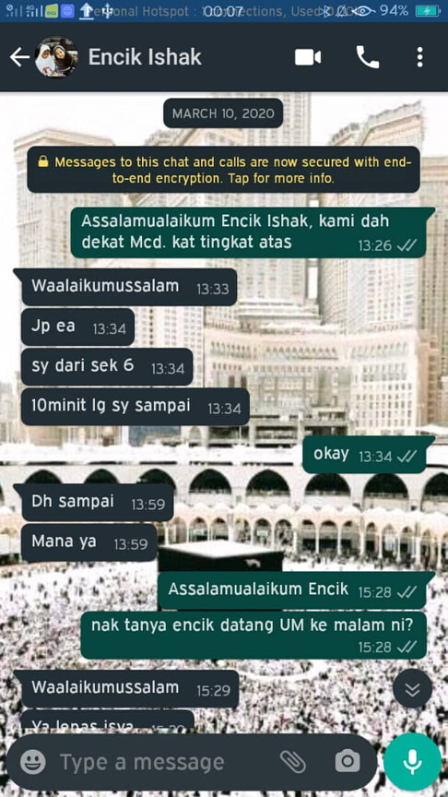
Requirement Elicitation
INTERVIEW
We have interviewed our stakeholder, Encik Ishak to understand their problems and gather requirements.

Slide 21
Interview Result I
WHATSAPP & TELEGRAM PLATFORM
T check staff availability by voting one week earlier to invite to a meeting.
To update their task progress.
TRADITIONAL & MANUAL METHOD
Using paper to sign their meeting attendance.
TASK DISTRIBUTION
Those who are unable to attend the meeting will
still receive tasks. The teacher is responsible to take note on his/her tasks.

Slide 22
Interview Result II
TASK OUT OF SCHOOL
Clerk receive a letter from government or any organization that requiring the school to send representative to task that is
not within the school. Then the clerk has to inform and get approval from headmaster. After receive the approval, the clerk needs to inform selected teacher(s).
HOURLY LEAVE APPLICATION
All staff require to apply hourly leave using
logbook and notify headmaster via WhatsApp to receive approval.

Slide 23
Interview Result III
HOURLY LEAVE APPLICATION
All staff require to apply hourly leave using
logbook and notify headmaster via WhatsApp to receive approval.

Slide 24
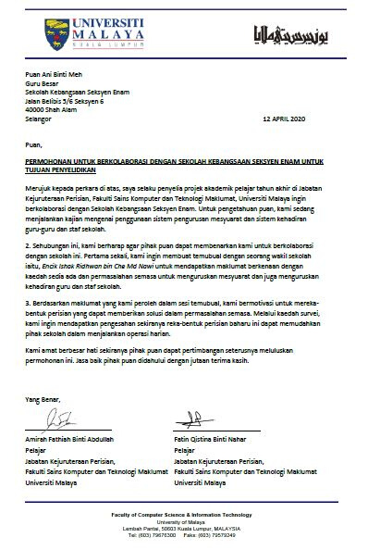
Stakeholder Collaboration
Proof
COLLABORATION LETTER LINK

Slide 25
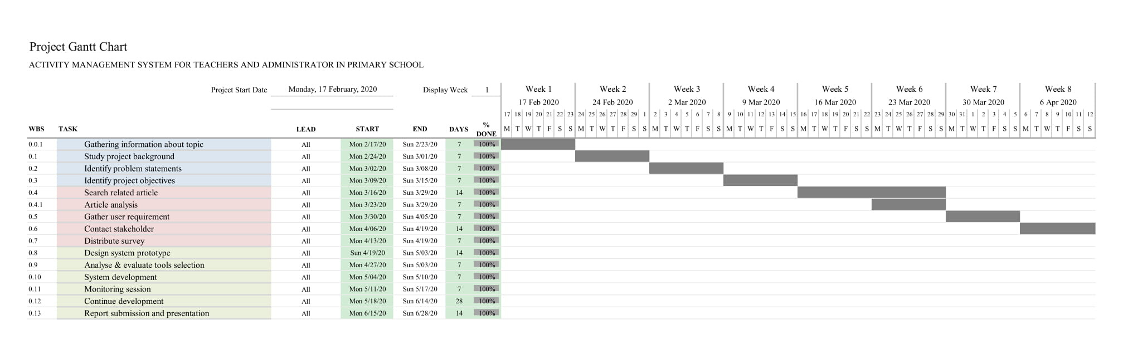
Project Schedule Week 1 -8

Slide 26
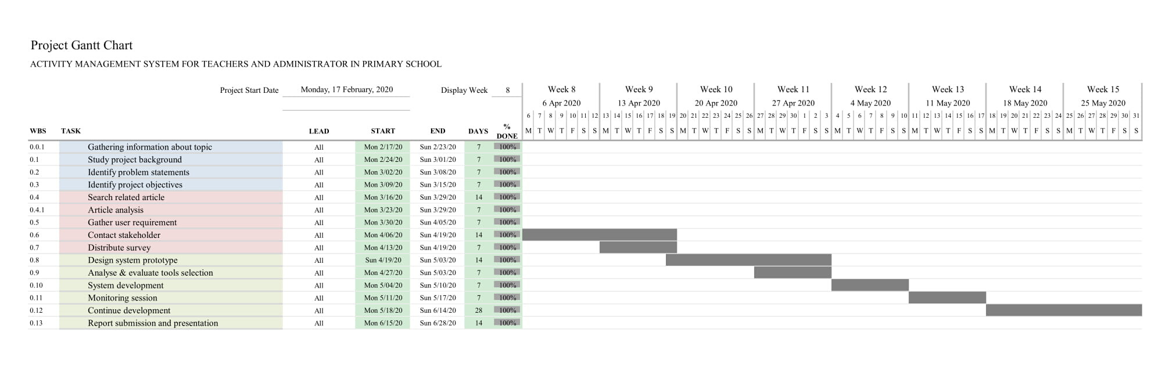
Project Schedule Week 8 - 15

Slide 27
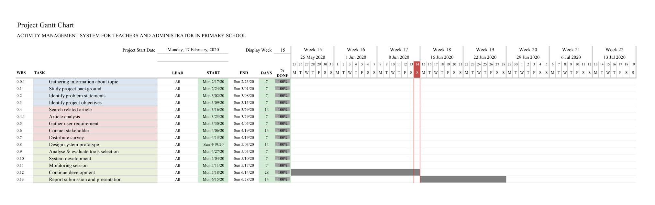
Project Schedule Week 15 - 19

Slide 28
PROTOTYPE
We use this prototype as one interview materials to receive feedback from Encik Ishak
Link

Slide 29
1. The system shall allow meeting inviter to invite
staff to meeting based on their availability and workload percentage.
2. The system shall allow task assigner to assign task to staff based on their workload percentage.
4. The system shall allow Headmaster to make
approval to all assigned tasks that involve out of school.
5. The system shall be able to provide accept or
reject option for meeting attendees after receiving meeting invitation.
Functional Requirements
ACTIVITY MANAGEMENT MODULE

Slide 30
6. The system shall allow scheduler to send
reminder to all task owner based on date and time.
7. The system shall be able to allow minute taker and organizer to manage meeting info.
8. The system shall allow user to view overall task
progress.
9. The system shall allow user to update task
progress.
Functional Requirements
ACTIVITY MANAGEMENT MODULE

Slide 31
Maintainability
The system shall be able to backup data.
Non-Functional Requirements I
Accuracy
The system shall be able to provide accurate information
Usability
The user interface should be intuitive and easy to use

Slide 32

Analysis & Design
NEXT:
Use case diagram
Use case description
Activity diagram

Slide 33
Use Case Diagram
Click this link for a better view

Slide 34
Use Case Diagram - My module
Click this link for a better view

Slide 35
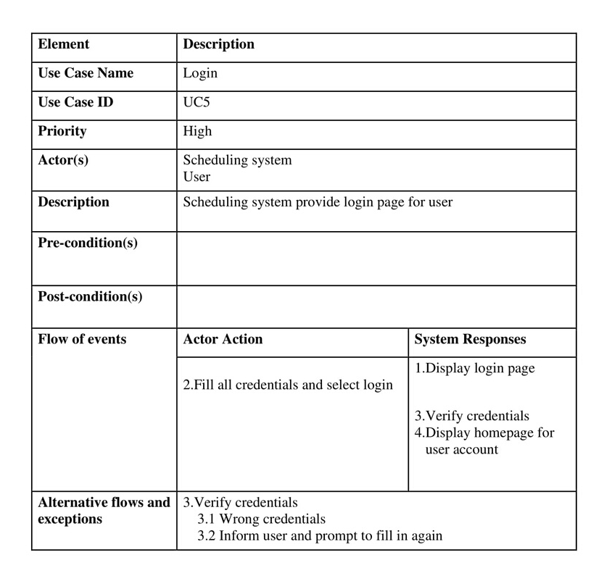
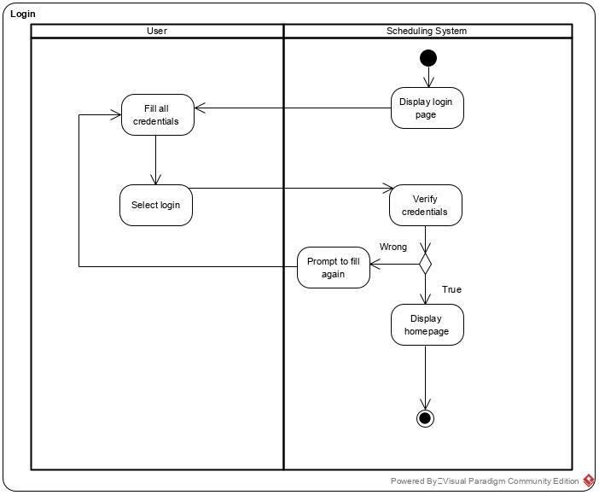
Login

Slide 36
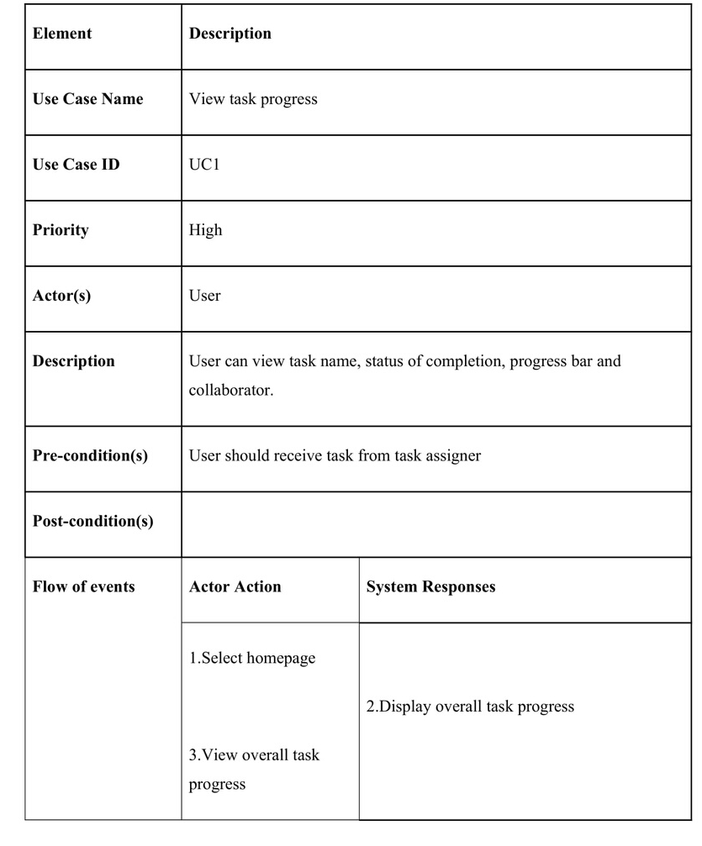
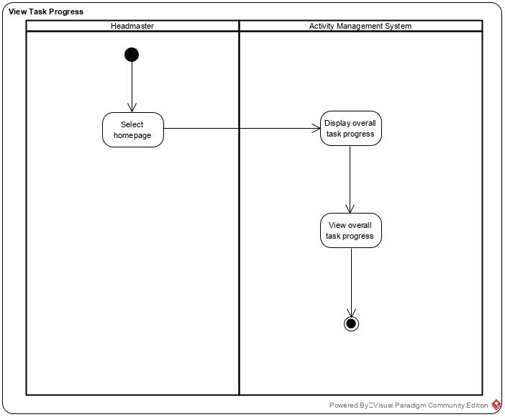
View Task Progress

Slide 37
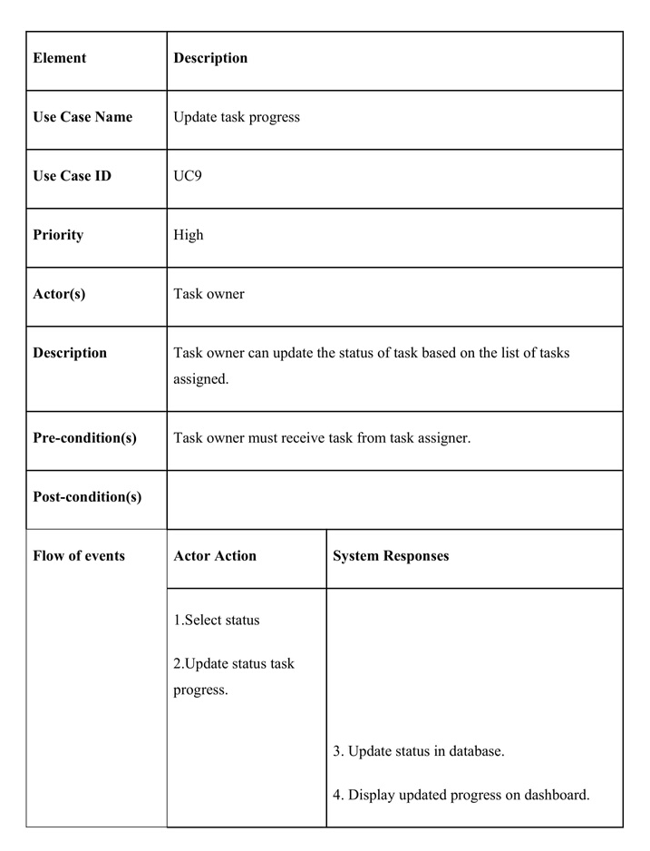
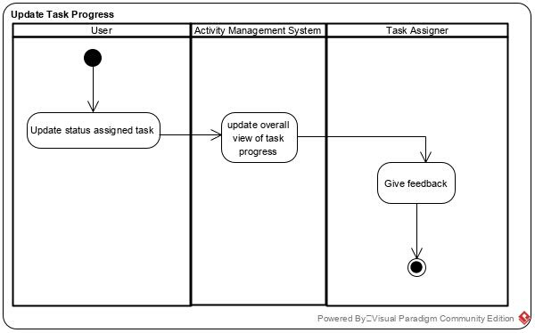
Update Task Progress

Slide 38
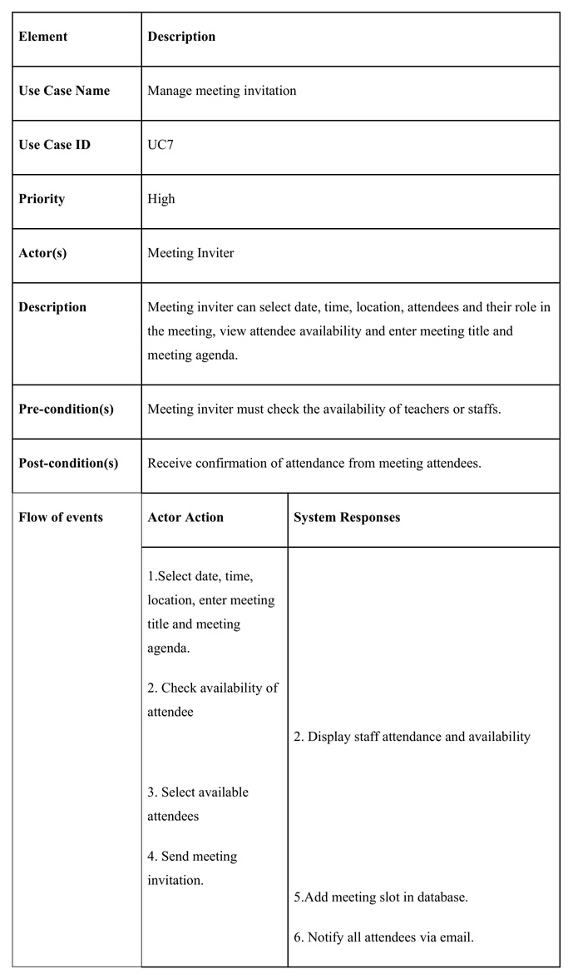
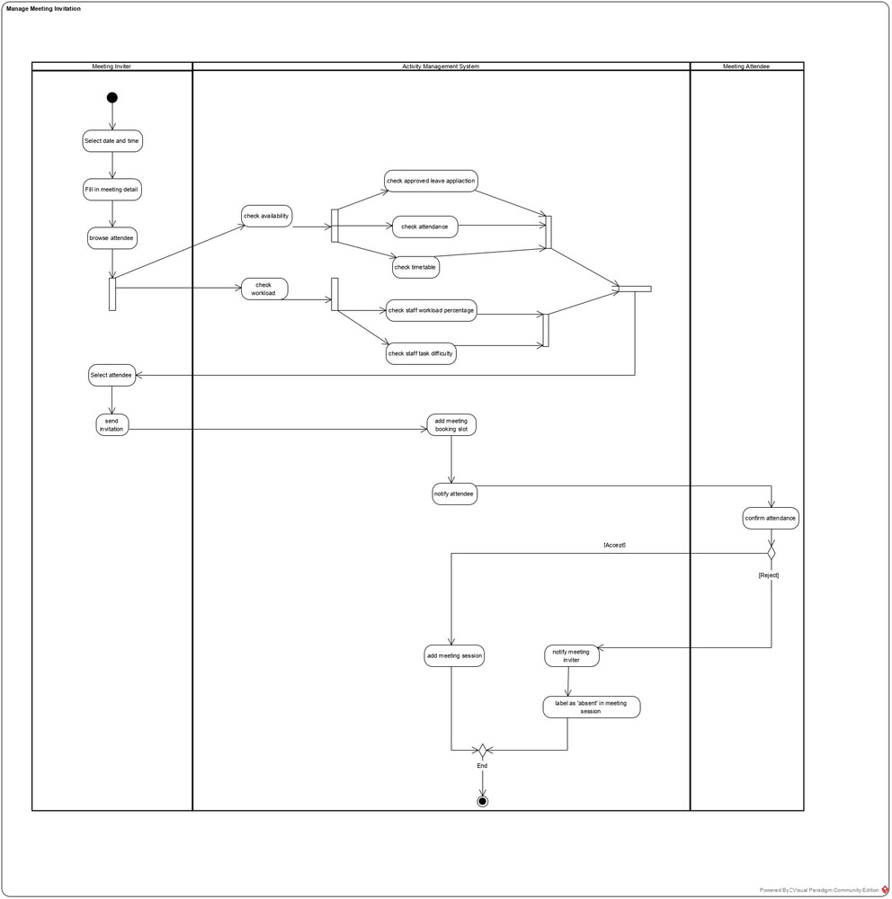
Manage Meeting Invitation

Slide 39
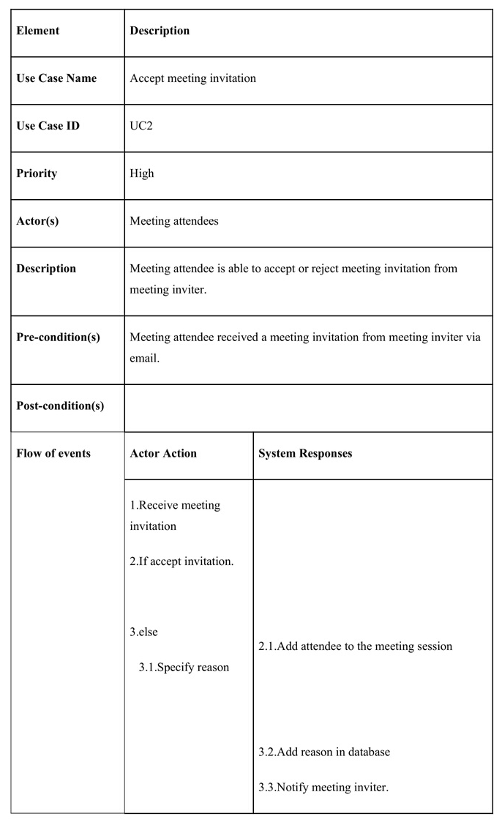
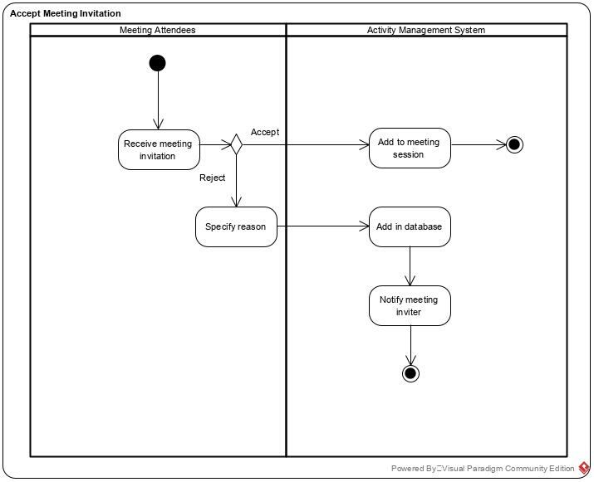
Accept Meeting Invitation

Slide 40
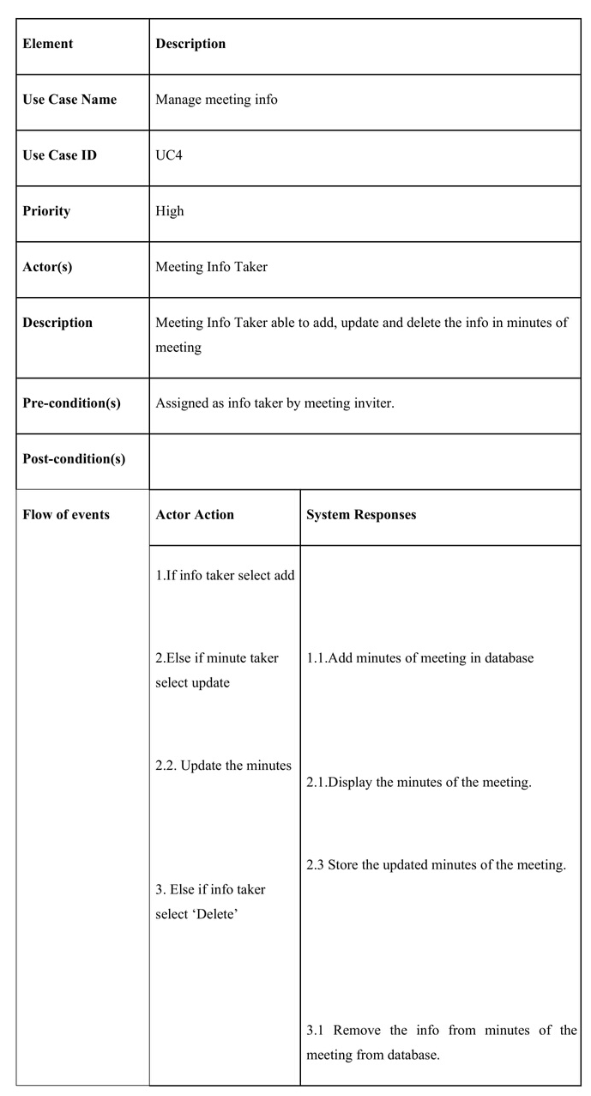
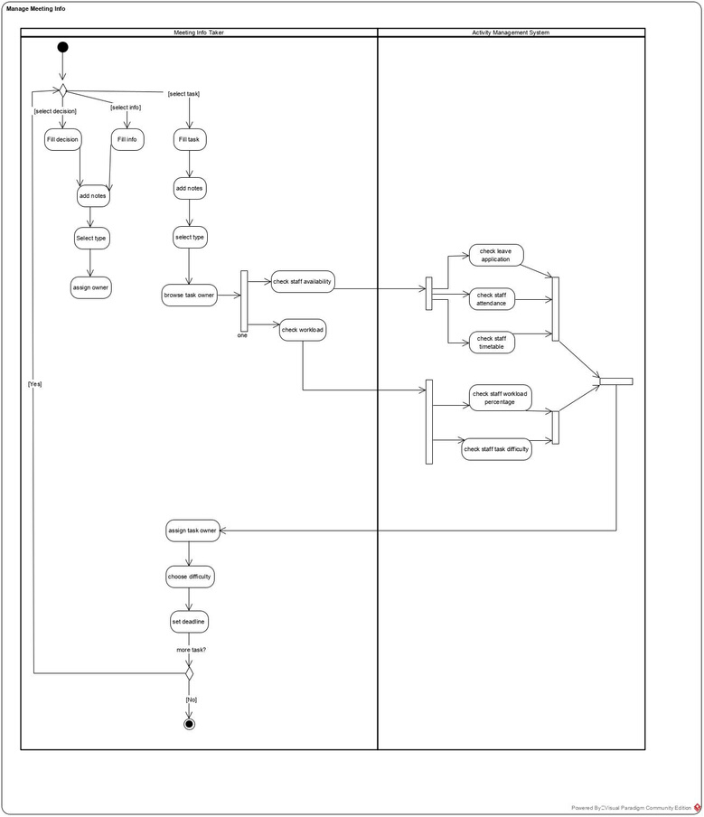
Manage Meeting Info

Slide 41
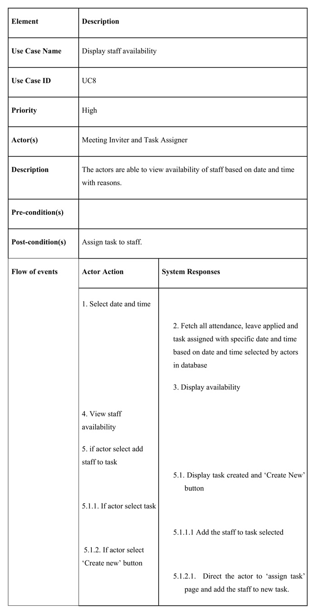
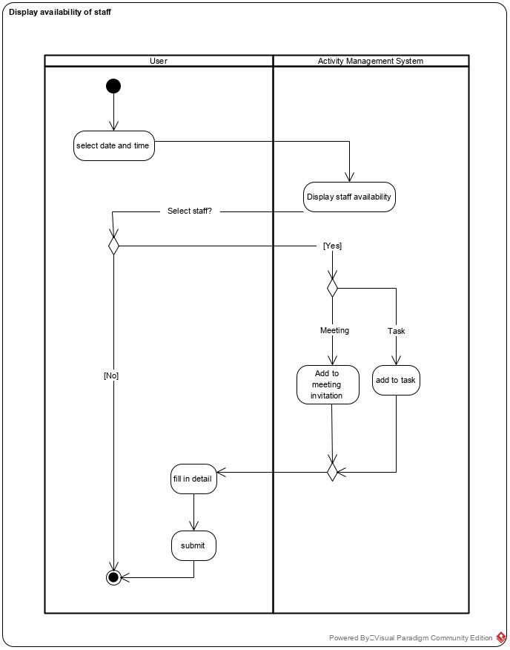
Display Staff Availability

Slide 42
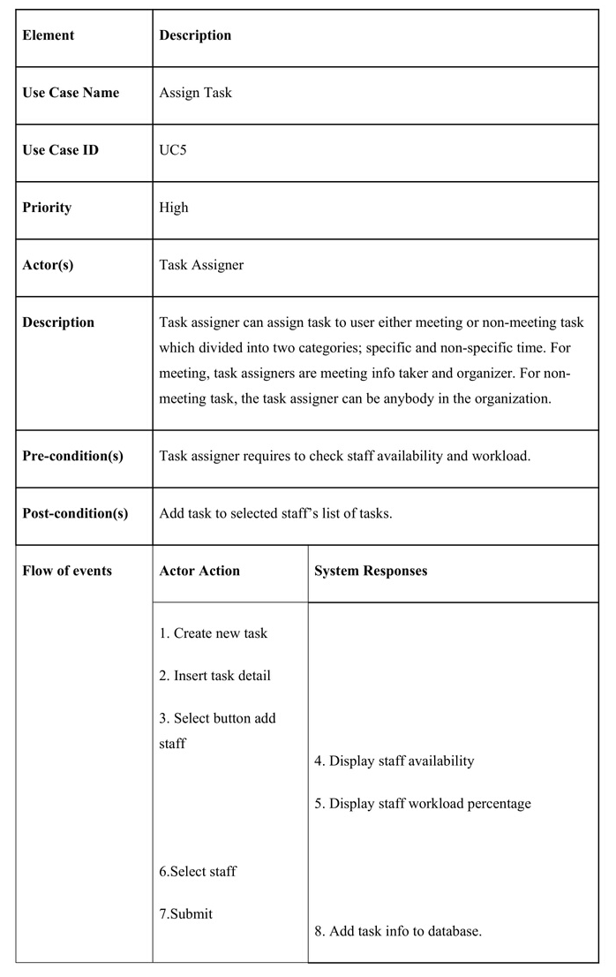
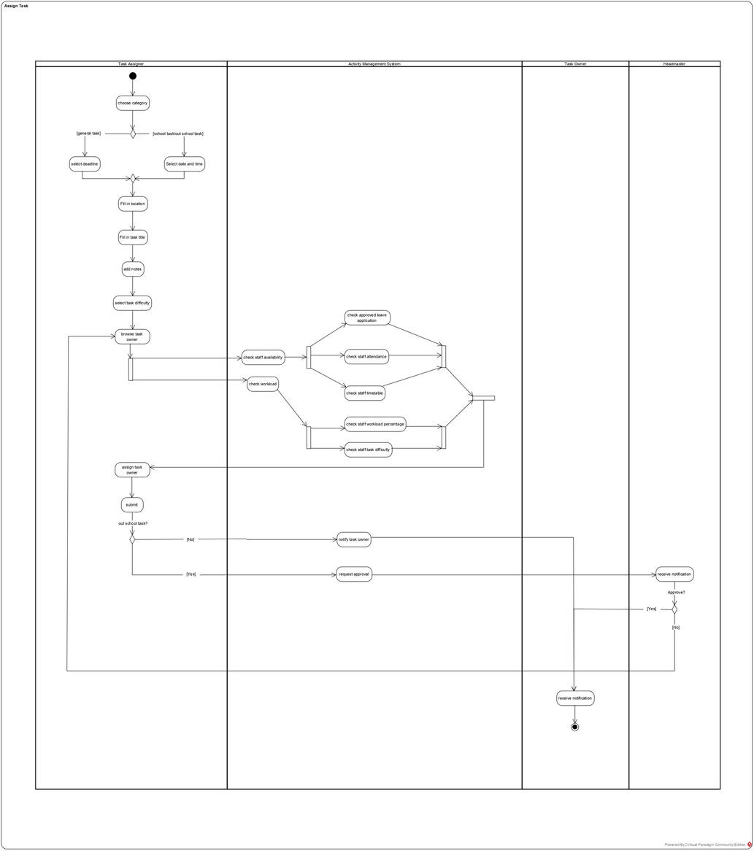
Assign Task I

Slide 43
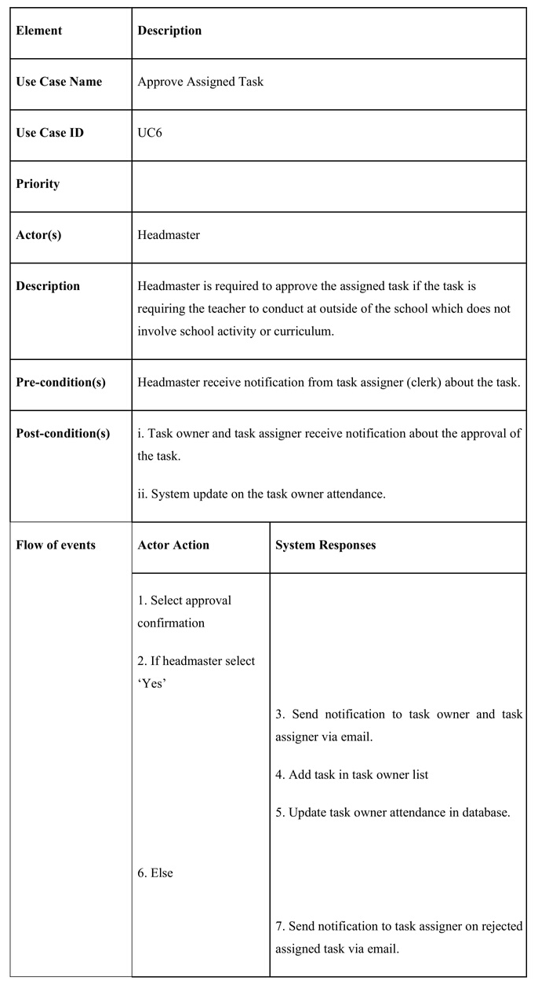
Assign Task II (Approve Assigned Task)

Slide 44
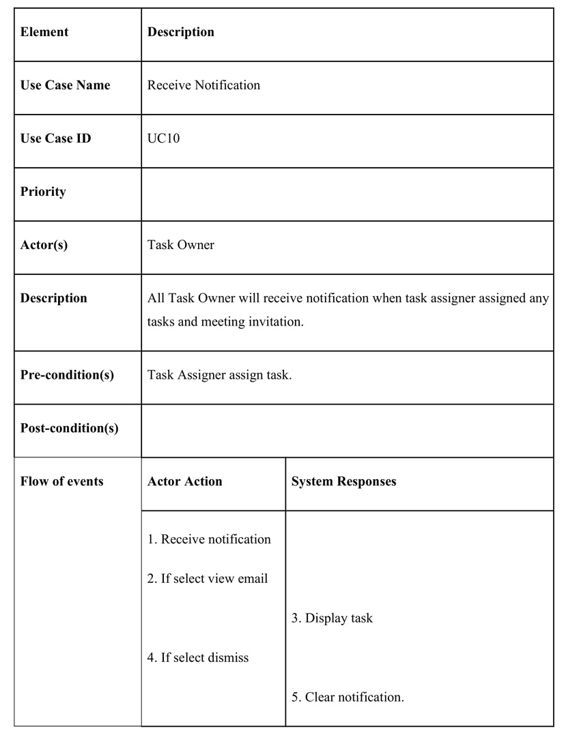
Receive Notification

Slide 45
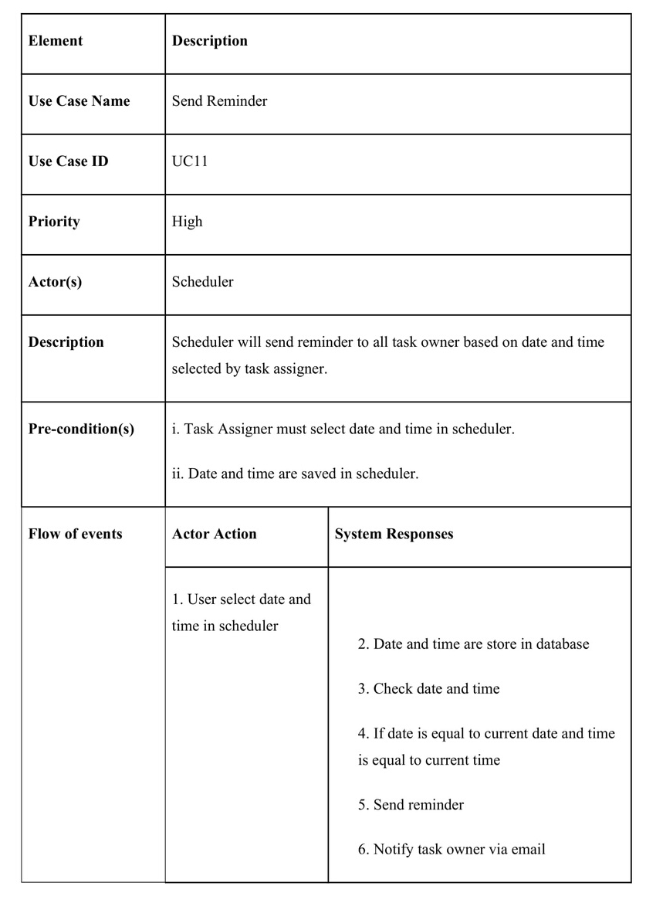
Send Reminder

Slide 46
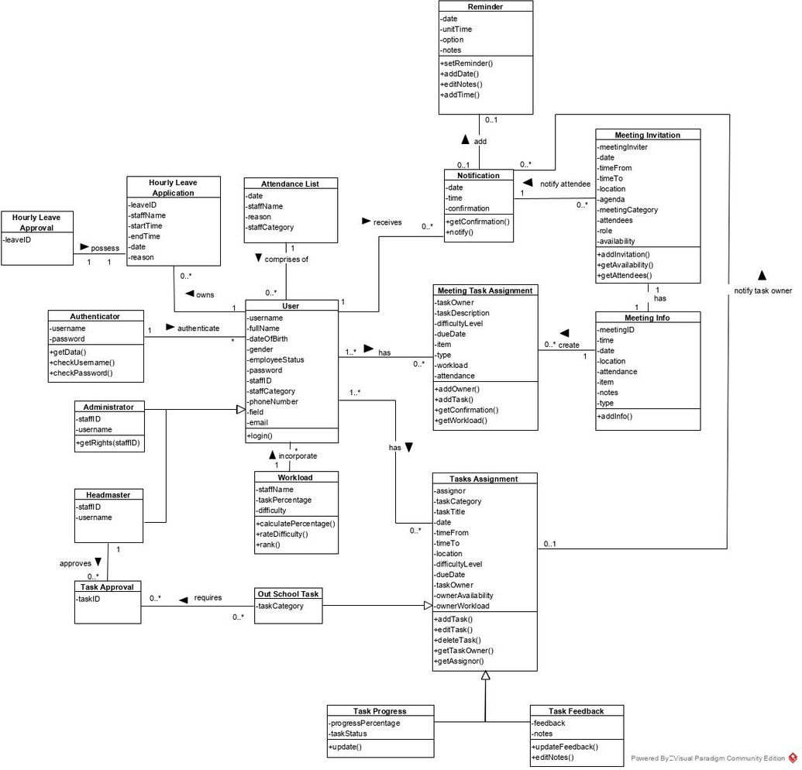
Class Diagram

Slide 47



MASTERY OF TOOLS
Node JS
Express JS
MongoDB Compass Community

Slide 48
References
SDLC Overview. (n.d.). Retrieved from
https://www.tutorialspoint.com/sdlc/sdlc_overview. htms.
SDLC Iterative Model. (2019, March 6). Retrieved from
https://www.w3schools.in/sdlctutorial/iterative model/
Requirements Elicitation in Software Engineering. (2019, July 11). Retrieved from
https ://www.testbytes.net/blog/requirements elicitation/
Installing. (n.d.). Retrieved from
https://expressjs.com/en/starter/installing.html
Renaud, & Prathyusha . (2020, January 12). Login and Registration in NodeJS,Express and mongoDB
Retrieved from
https://codebun.com/login registration nodejsexpress mongodb/

